Slide 1
Contextual Gaussian Process Bandit Optimization
Paper Review
Andreas Krause and Cheng Soon Ong
Department of Computer Science, ETH Zurich

Slide 2
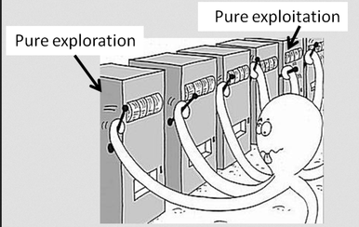
1. Problem Setting
What is the multi-armed bandit problem?
Exploration
an agent simultaneously attempts to acquire new knowledge
Exploitation
an agent optimizes its decision based on existing knowledge
Figure. Should I keep pulling the best lever so far or should I explore a new lever?
Source from http://www.primarydigit.com/blog/multi-arm-bandits-explorationexploitation-trade-off

Slide 3
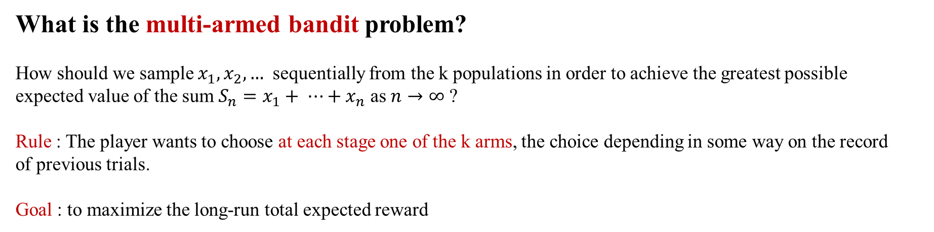
Optimization &
Statistical
Inference Lab
1. Problem Setting
What is the multi-armed bandit problem?
How should we sample $x_{1},x_{2}, …$ sequentially from the k populations in order to achieve the greatest possible expected value of the sum $S_{n}=x_{1}+ ⋯+x_{n}$ as $n→∞$ ?
Rule : The player wants to choose at each stage one of the k arms, the choice depending in some way on the record of previous trials.
Goal : to maximize the long-run total expected reward
Copyright ⓒ 2018 by Tae Hyeon Kim, Dept. of Knowledge and Service Engineering, KAIST

Slide 4
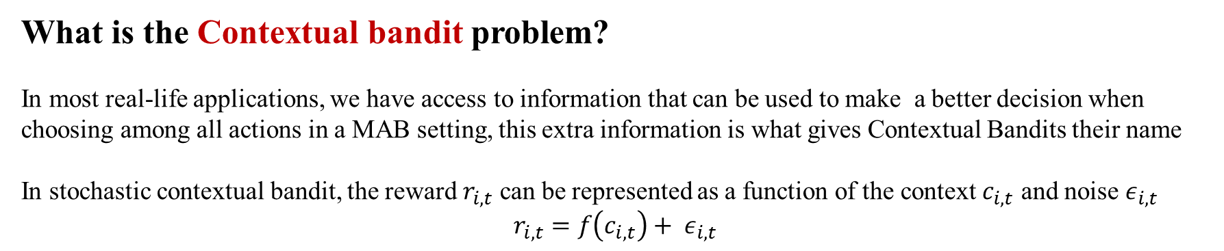
Optimization &
Statistical
Inference Lab
1. Problem Setting
What is the Contextual bandit problem?
In most real-life applications, we have access to information that can be used to make a better decision when choosing among all actions in a MAB setting, this extra information is what gives Contextual Bandits their name
In stochastic contextual bandit, the reward $r_{i,t}$ can be represented as a function of the context $c_{i,t}$ and noise $ε_{i,t}$
$$r_{i,t}=f\left(c_{i,t}\right)+ ε_{i,t }$$
Copyright ⓒ 2018 by Tae Hyeon Kim, Dept. of Knowledge and Service Engineering, KAIST

Slide 5
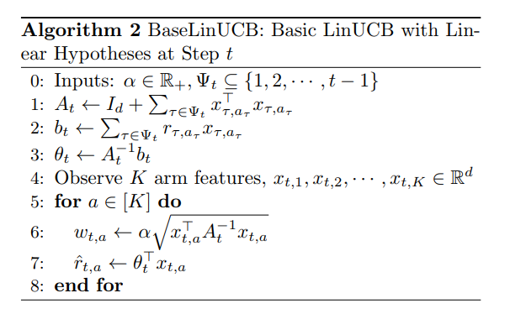
2. Previous Algorithm
LinUCB

Slide 6
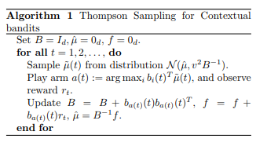
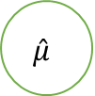




2. Previous Algorithm
$$\hat{μ}$$
$$v^{2}B^{−1}$$
Thompson Sampling
$$\tilde{μ}$$
$$b_{i}$$
i=1, … , K
Linear Payoff
$$r_{i}$$
i=1, … , K

Slide 7
All previous algorithms deal with the linear case. Then how about nonlinear case?
If we assume f is a member of exponential family, we can use ${\text{GLM}\text{-}\text{UCB}}^{1}$.
If we assume f is sampled from a Gaussian Process, we can use ${\text{GP}\text{-}\text{UCB}}^{2}$/${\text{CGP}\text{-}\text{UCB}}^{3}$.
If we assume f is an element of Reproducing Kernel Hilbert Space, we can use ${\text{KernelUCB}}^{4}$.
Also, we can use Thompson Sampling if we know the form of probability distribution.
GP-UCB is the algorithm of the context-free case.
1. Filippi et al. Parametric Bandits: The Generalized Linear Case NIPS 2010
2. Srinivas et al. Gaussian Process Optimization in the Bandit Setting: No Regret and Experimental Design ICML, 2010.
3. This Paper will deal with this part (NIPS 2011)
4. Valko el al. Finite-Time Analysis of Kernelized Contextual Bandits, UAI, 2013.

Slide 8
Stochastic Contextual Bandit

Slide 9
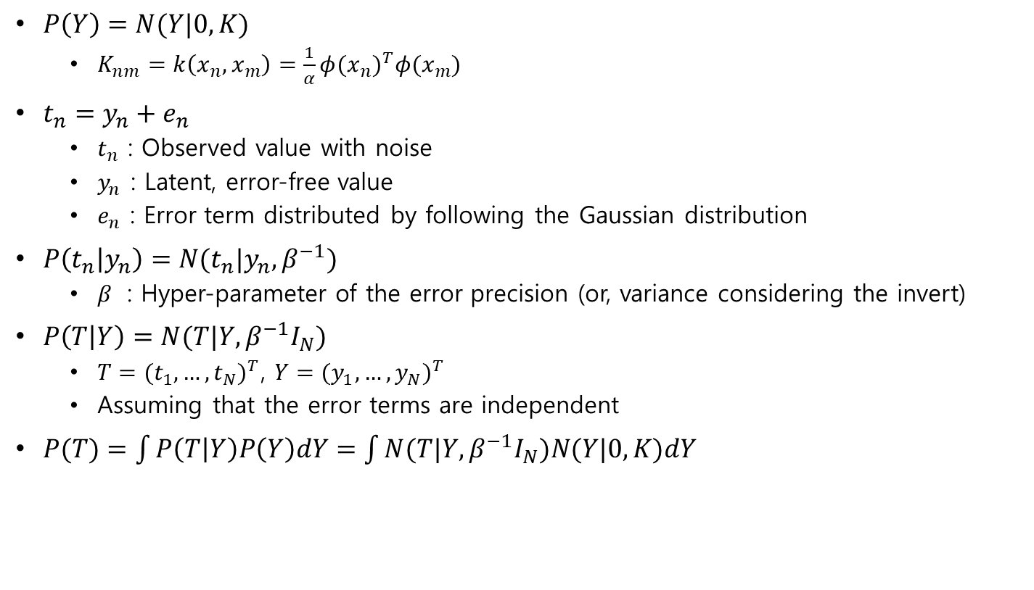
Before algorithm….
$P\left(Y\right)=N(Y|0,K)$
$K_{nm}=k\left(x_{n},x_{m}\right)=\frac{1}{α}{φ(x_{n})}^{T}φ(x_{m})$
$t_{n}=y_{n}+e_{n}$
$t_{n}$ : Observed value with noise
$y_{n}$ : Latent, error-free value
$e_{n}$ : Error term distributed by following the Gaussian distribution
$P\left(t_{n} | y_{n}\right)=N(t_{n}|y_{n}, β^{−1})$
$β$ : Hyper-parameter of the error precision (or, variance considering the invert)
$P\left(T | Y\right)=N(T|Y, β^{−1}I_{N})$
$T={(t_{1},…,t_{N})}^{T}$, $Y={(y_{1},…,y_{N})}^{T}$
Assuming that the error terms are independent
$P(T)=\int{P\left(T | Y\right)P\left(Y\right)dY}=\int{N(T|Y, β^{−1}I_{N})N(Y|0,K)dY}$
These are from the lecture note of IE661-AI and DM2-Gaussian Process-ver-2 made by prof Moon

Slide 10
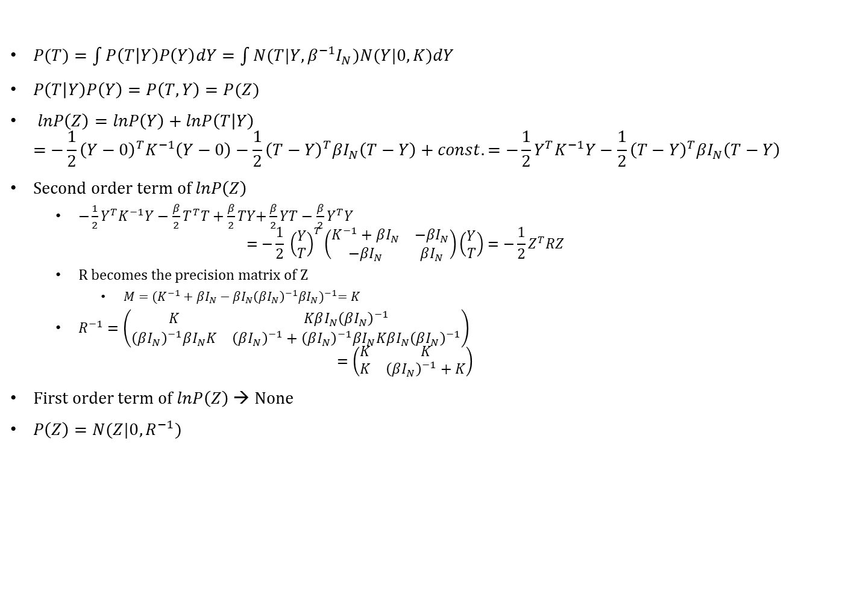
Before algorithm….
$P(T)=\int{P\left(T | Y\right)P\left(Y\right)dY}=\int{N(T|Y, β^{−1}I_{N})N(Y|0,K)dY}$
$P\left(T | Y\right)P\left(Y\right)=P\left(T,Y\right)=P(Z)$
$lnP\left(Z\right)=lnP\left(Y\right)+lnP\left(T | Y\right)$ $=−\frac{1}{2}{\left(Y−0\right)}^{T}K^{−1}\left(Y−0\right)−\frac{1}{2}{\left(T−Y\right)}^{T}βI_{N}\left(T−Y\right)+const.=−\frac{1}{2}Y^{T}K^{−1}Y−\frac{1}{2}{\left(T−Y\right)}^{T}βI_{N}\left(T−Y\right)+const.$
Second order term of $lnP\left(Z\right)$
$−\frac{1}{2}Y^{T}K^{−1}Y−\frac{β}{2}T^{T}T+\frac{β}{2}TY\text{+}\frac{β}{2}YT−\frac{β}{2}Y^{T}Y$ $=−\frac{1}{2} {\left(\begin{aligned}Y \\ T\end{aligned}\right)}^{T}\left(\begin{matrix}K^{−1}+βI_{N} & −βI_{N} \\ −βI_{N} & βI_{N}\end{matrix}\right)\left(\begin{aligned}Y \\ T\end{aligned}\right)=−\frac{1}{2}Z^{T}RZ$
R becomes the precision matrix of Z
$M={(K^{−1}+βI_{N}−βI_{N}{\left(βI_{N}\right)}^{−1}βI_{N})}^{−1}=K$
$R^{−1}=\left(\begin{matrix}K & KβI_{N}{\left(βI_{N}\right)}^{−1} \\ {\left(βI_{N}\right)}^{−1}βI_{N}K & {\left(βI_{N}\right)}^{−1}+{\left(βI_{N}\right)}^{−1}βI_{N}KβI_{N}{\left(βI_{N}\right)}^{−1}\end{matrix}\right)$ $=\left(\begin{matrix}K & K \\ K & {\left(βI_{N}\right)}^{−1}+K\end{matrix}\right)$
First order term of $lnP\left(Z\right)$ → None
$P\left(Z\right)=N(Z|0,R^{−1})$
These are from the lecture note of IE661-AI and DM2-Gaussian Process-ver-2 made by prof Moon

Slide 11
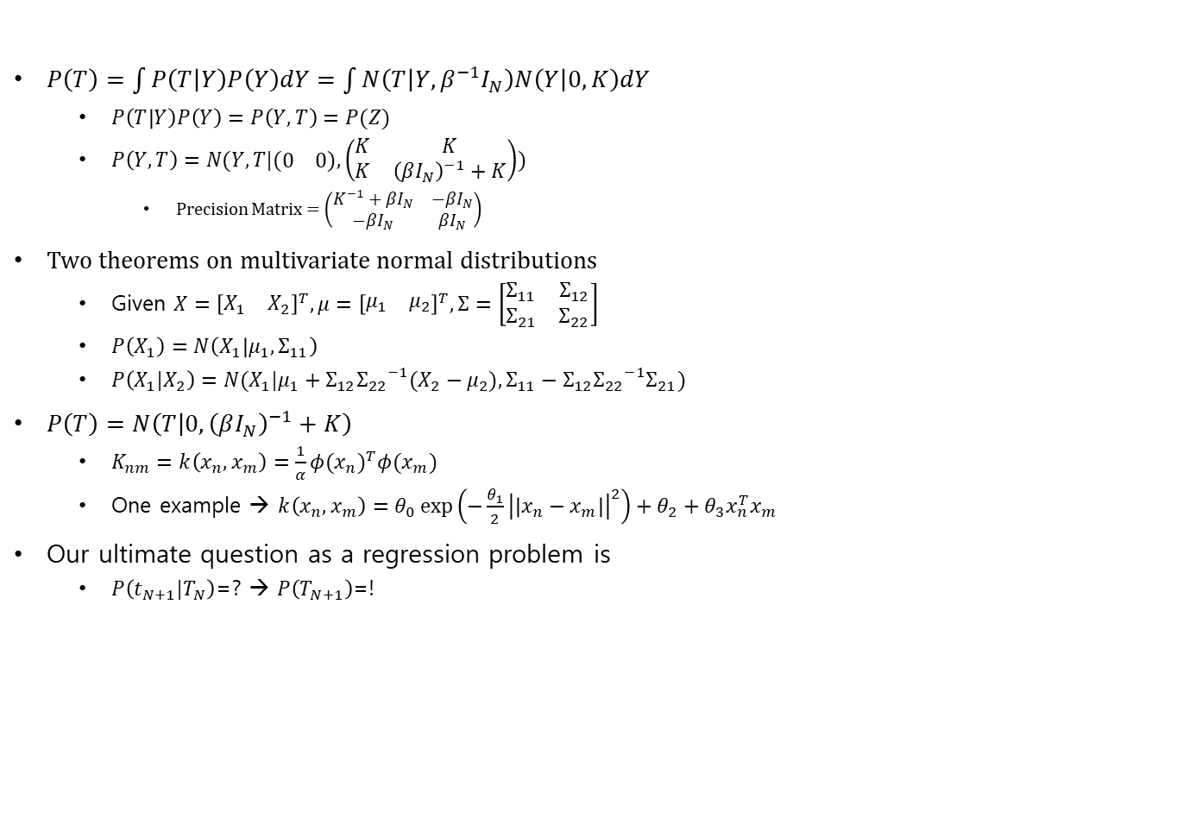
$P\left(T\right)=\int{P\left(T | Y\right)P\left(Y\right)dY}=\int{N\left(T | Y, β^{−1}I_{N}\right)N\left(Y | 0,K\right)dY}$
$P\left(T | Y\right)P\left(Y\right)=P\left(Y,T\right)=P(Z)$
$P\left(Y,T\right)=N(Y,T|(\begin{matrix}0 & 0\end{matrix}),\left(\begin{matrix}K & K \\ K & {\left(βI_{N}\right)}^{−1}+K\end{matrix}\right))$
Precision Matrix = $\left(\begin{matrix}K^{−1}+βI_{N} & −βI_{N} \\ −βI_{N} & βI_{N}\end{matrix}\right)$
Two theorems on multivariate normal distributions
Given $X={\left[\begin{matrix}X_{1} & X_{2}\end{matrix}\right]}^{T},μ={\left[\begin{matrix}μ_{1} & μ_{2}\end{matrix}\right]}^{T},Σ=\left[\begin{matrix}Σ_{11} & Σ_{12} \\ Σ_{21} & Σ_{22}\end{matrix}\right]$
$P\left(X_{1}\right)=N\left(X_{1} | μ_{1},Σ_{11}\right)$
$P\left(X_{1}|X_{2}\right)=N(X_{1}|μ_{1}+Σ_{12}{Σ_{22}}^{−1}(X_{2}−μ_{2}),Σ_{11}−Σ_{12}{Σ_{22}}^{−1}Σ_{21})$
$P\left(T\right)=N\left(T | 0,{\left(βI_{N}\right)}^{−1}+K\right)$
$K_{nm}=k\left(x_{n},x_{m}\right)=\frac{1}{α}{φ(x_{n})}^{T}φ(x_{m})$
One example → $k\left(x_{n},x_{m}\right)=θ_{0}\exp\left(−\frac{θ_{1}}{2}{\left|\left|x_{n}−x_{m}\right|\right|}^{2}\right)+θ_{2}+θ_{3}x_{n}^{T}x_{m}$
Our ultimate question as a regression problem is
$P\left(t_{N+1}|T_{N}\right)$=? → $P\left(T_{N+1}\right)$=!
These are from the lecture note of IE661-AI and DM2-Gaussian Process-ver-2 made by prof Moon

Slide 12
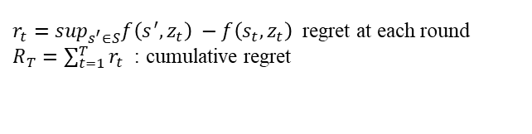
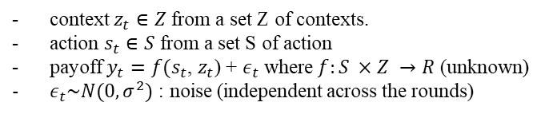


CGP-UCB
How it work?
context $z_{t}∈Z$ from a set Z of contexts.
action $s_{t}∈S$ from a set S of action
payoff $y_{t}=f(s_{t}$, $z_{t}$) + $ε_{t}$ where $f:S ×Z →R$ (unknown)
$ε_{t}\sim N(0, σ^{2})$ : noise (independent across the rounds)
$r_{t}=\sup_{s^{′}∈S}f\left(s^{′}, z_{t}\right) −f\left(s_{t}, z_{t}\right)$ regret at each round
$R_{T}=\sum_{t=1}^{T}{r_{t}}$ : cumulative regret
$X=S ×Z$ : the set of all action-context pairs
$μ: X →R, μ\left(x\right)=E[f\left(x\right)]$
Mean function
$k:X ×X →R$, $k\left(x,x^{′}\right)=E[\left(f\left(x\right)− μ\left(x\right)\right)\left(f\left(x^{′}\right)−μ\left(x^{′}\right)\right)]$
[WLOG] $μ≡0, k\left(x,x\right)≤1, for all x∈X$
Covariance function

Slide 13
CGP-UCB
How to train?
Sigma is from error, and the identity matrix is from the assumption of the independence between error terms
context $z_{t}∈Z$ from a set Z of contexts.
action $s_{t}∈S$ from a set S of action
payoff $y_{t}=f(s_{t}$, $z_{t}$) + $ε_{t}$ where $f:S ×Z →R$ (unknown)
$ε_{t}\sim N(0, σ^{2})$ : noise (independent across the rounds)
$r_{t}=\sup_{s^{′}∈S}f\left(s^{′}, z_{t}\right) −f\left(s_{t}, z_{t}\right)$ regret at each round
$R_{T}=\sum_{t=1}^{T}{r_{t}}$ : cumulative regret
$X=S ×Z$ : the set of all action-context pairs
$μ: X →R, μ\left(x\right)=E[f\left(x\right)]$
Mean function
$k:X ×X →R$, $k\left(x,x^{′}\right)=E[\left(f\left(x\right)− μ\left(x\right)\right)\left(f\left(x^{′}\right)−μ\left(x^{′}\right)\right)]$
[WLOG] $μ≡0, k\left(x,x\right)≤1, for all x∈X$
Using this upper confidence bound
Covariance function

Slide 14
Next week
Before preview…
The regret $R_{T}$ of the GP-UCB algorithm can be bounded as $O^{∗}(\sqrt{Tγ_{T}}$)
Shannon entropy
It quantifies the mutual information between the observed context-action pairs and the estimated payoff function f

Slide 15
A known GP prior and finite X
Infinite X with mild assumptions about k
f has low “complexity” as quantified in terms of the Reproducing Kernel Hilbert Space norm associated with kernel k.

Slide 17
CGP-UCB
Main Contribution
Develop an efficient algorithm, CGP-UCB, for the contextual GP bandit problem;
Show that by flexibly combining kernels over contexts and actions, CGP-UCB can be applied to a variety of applications;
Provide a generic approach for deriving regret bounds for composite kernel functions;
Evaluate CGP-UCB on two case studies, related to automated vaccine design and sensor management.
The posterior inference can be performed in closed form.

